Slide 1


Bank Loan Prediction for Customers
Presented by Mahmoud Reda

Slide 2

Intro:
Banks face a problem with their customers, which is related to taking loans from the bank based on their data
Business Case:
Determining the status of the applicant for a loan from the bank
Question:
Is the customer qualified for a loan from the bank ?

Slide 3
About The Data
Features
Personal Features
Loan Features
Bank Features
Lead Creation Date
Employer Code
Employer Category1
Employer Category2
Customer Existing Primary Bank Code
Primary Bank Type - Var1
Existing EMI - Contacted
Source Category - Source
ID
Gender
DOB
City Code
City Category
Monthly Income
Loan Amount
Loan Period
Interest Rate
EMI

Slide 4
Analysis Questions :
1) What is Loan Repayment Period is most popular ?
2) Why do most clients turn to the loan repayment period over 5 years ?
3) Why do they refrain from taking the loan repayment period over 6 year?
4) What is Loan Amount for Each Category of Clients ?
5) What is monthly income for each category of clients ?
6) Is there a relationship between the monthly income of customers and
the value of the loan?
7) IS loan amount affect EMI ?
8) What is Distribution date for creating accounts in the bank ?
9) What is gender of the applicant that most frequent?
10) Which gender is most acceptable?
11) What is average monthly income for each gender?
12) Is age of applicant affect approved ?
13) At what age is the demand for loan ?
14) Which source category is the most rejecting of loans?
15) What is the highest and Lowest interest rate?

Slide 5
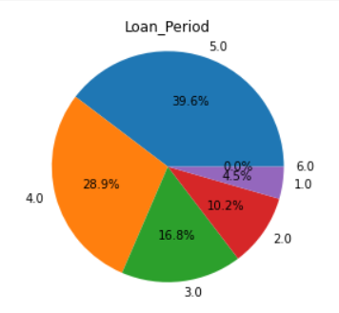
Loan Repayment Period
Loan Period (years) | Count
5.0 | 16653
4.0 | 12139
3.0 | 7059
2.0 | 4266
1.0 | 1886
6.0 | 1
- 39 percent of the total number of customers in the bank tend to repay the loan over 5 years, and only
one customer takes the loan over 6 years.

Slide 6
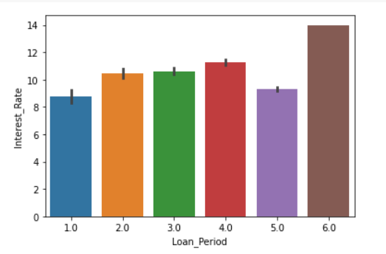
1)Why do most clients turn to the loan repayment period over 5 years ? 2)Why do they refrain from taking the loan repayment period over 6 year?
- Customers tend to take the loan over 5 years,
because the interest rate on the loan is low
- Customers stay away from taking the loan
over 6 years because the interest rate is high

Slide 7
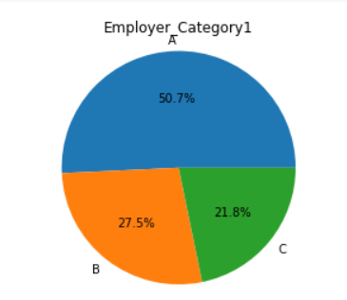
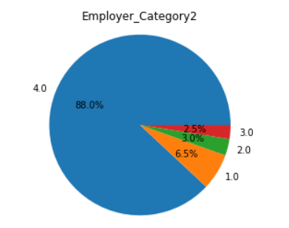
Employer Category1 & EmployerCategory2
Employer Category1 | Count
A | 33336
B | 18056
C | 14303
Employer Category2 | Count
1.0 | 4258
2.0 | 1955
3.0 | 1620
4.0 | 57582
- Category1 (A) is the most popular.
- Category2 (4.0) is the most popular.

Slide 8
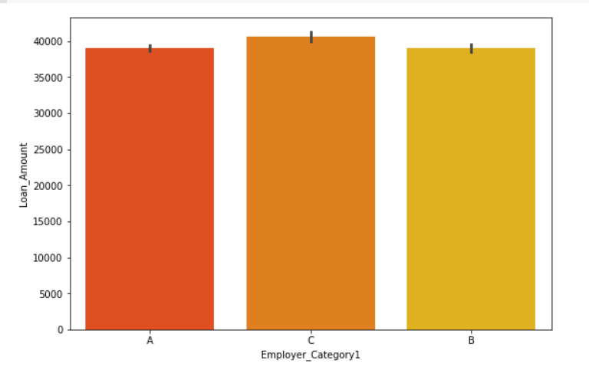
Loan Amount for Each Category of Clients (Employer Category1)
Average loan value for each category of clients
Employer Category1 | Loan Amount (USD)
A | 39052.239902
B | 38992.524917
C | 40615.580286
- Category C is the category of clients with the
most large loans, while the same in both categories A and B

Slide 9
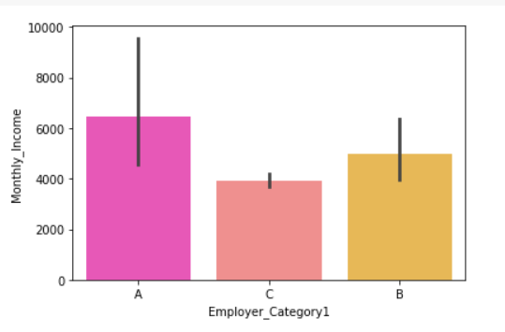
Is there a relationship between the monthly income of customers and the value of the loan?
Average monthly income for each category of clients
Employer Category1 | Monthly Income(USD)
A | 6457.368677
B | 4981.735329
C | 3909.159491
Category C is the category of clients with the lowest in monthly income
Customers with the highest monthly income are the lowest in the value of the amount of loans

Slide 10
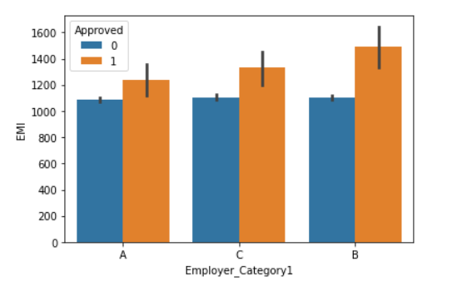
Average Equal monthly installments for 2 classes about Employer category1
Employer Category1 | Approved | EMI
A | 0 | 1084.932369
 | 1 | 1236.283133
B | 0 | 1100.353450
 | 1 | 1489.555556
C | 0 | 1106.335471
 | 1 | 1329.206667
- Employer Category1 B is the highest in EMI in case
the loan is accepted
- Most of Employer Category1 ‘s pay Close EMI in case
the loan is rejected

Slide 11
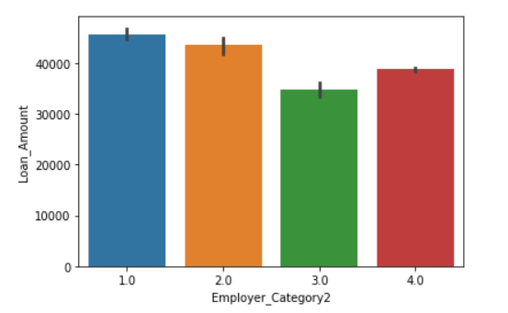
Loan Amount for Each Category of Clients (Employer Category2)
Average loan value for each category of clients
Employer_Category2 | Loan Amount (USD)
1.0 | 45730.228196
2.0 | 43501.812908
3.0 | 34860.329777
4.0 | 38775.237357
- Category (1.0) is the category of clients with the
most large loans, while category (3.0) with the
most small loans

Slide 12
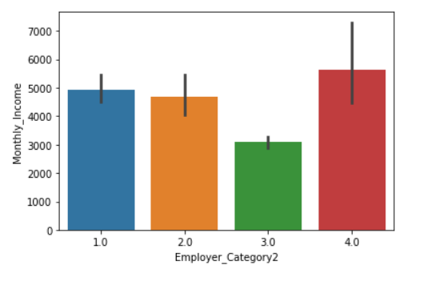
Monthly Income for Each Category of Clients (Employer Category2)
Average monthly income for each category of clients
Employer_Category2 | Monthly Income (USD)
1.0 | 4927.507539
2.0 | 4702.726905
3.0 | 3093.155370
4.0 | 5623.883642
-Category No.3 of clients are the lowest in the average monthly income and the lowest in the average value of loans

Slide 13
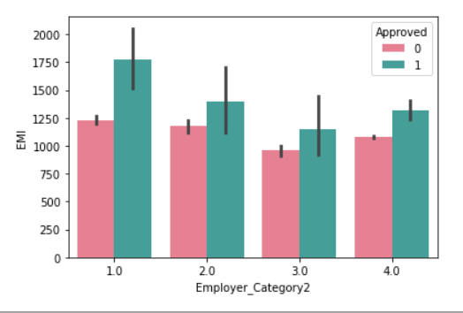
Average Equal monthly installments for 2 classes
about Employer category2
Employer Category2 | Approved | EMI
1.0 | 0 | 1227.084023
 | 1 | 1777.175000
2.0 | 0 | 1175.485842
 | 1 | 1391.793103
3.0 | 0 | 957.953020
 | 1 | 1152.277778
4.0 | 0 | 1082.869223
 | 1 | 1320.095238
The first category of customers is the highest in the average monthly premium values ​​in the case of rejection and acceptance
This is because the first category is the highest in the average loan values

Slide 14
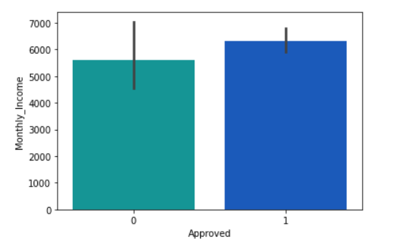
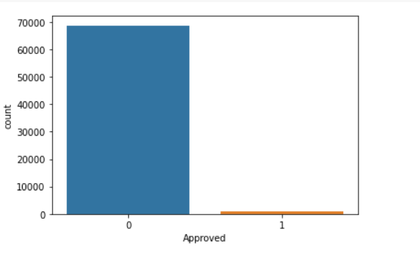
Monthly income and probability of approved
Average monthly income for each category
Approved | Monthly Income
0 | 5612.234088
1 | 6299.051471
Approved | ID
0 | 68693 (98.5%)
1 | 1020 (1.5%)
- Imbalance Classes

Slide 15
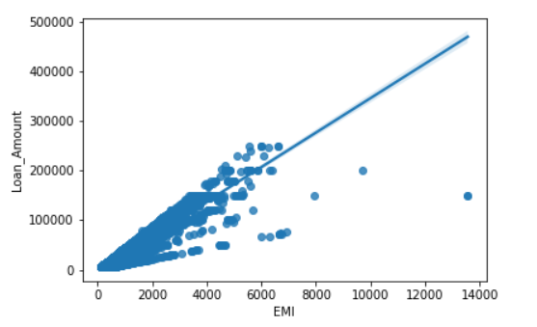
IS loan amount affect EMI ?
There are a positive correlation between Loan Amount and EMI

Slide 16
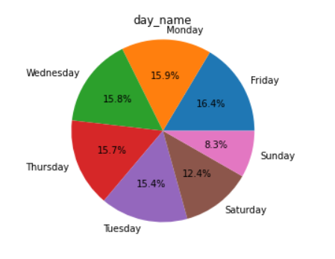
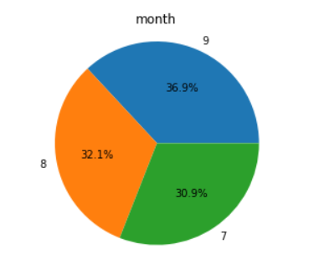
Distribution date for creating accounts in the bank
Day Name | Count
Friday | 11462
Monday | 11074
Wednesday | 11049
Thursday | 10931
Tuesday | 10768
Saturday | 8652
Sunday | 5777
Month | Count
9 | 25733
8 | 22404
7 | 21576

Slide 17
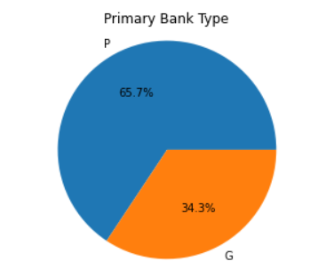
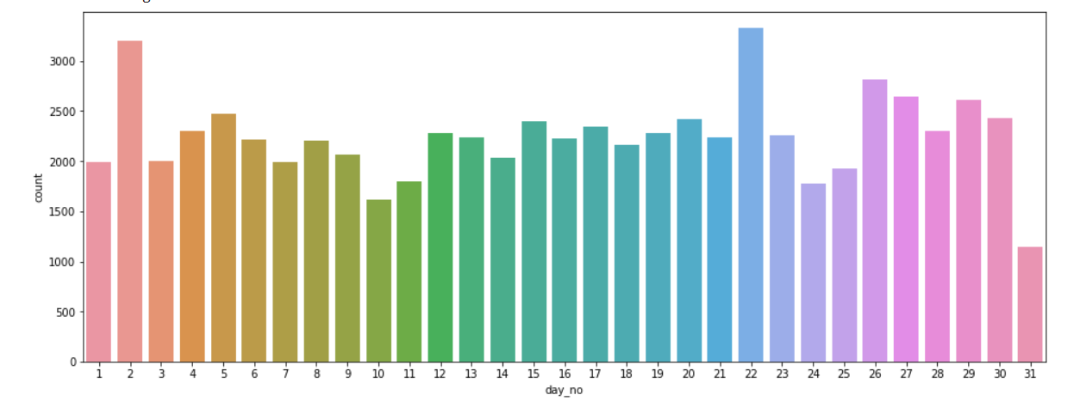
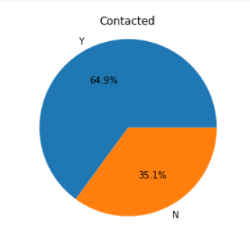
Cont..

Slide 18
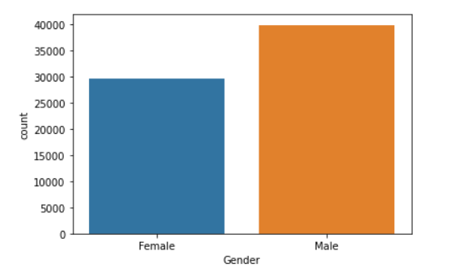
What is gender of the applicant that most frequent?
- More than half of the bank's clients are male
Gender | Count
Male | 39949 (57.3%)
Female | 29764 (42.7%)

Slide 19
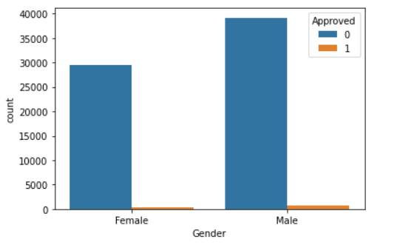
Which gender is most acceptable?
The number of male clients of the bank is more
accepting of loans than female clients
Gender | Approved | Count
Male | 0 | 39177 (98%)
 | 1 | 772 (2%)
Female | 0 | 29516 (99.1%)
 | 1 | 248 (0.9%)

Slide 20
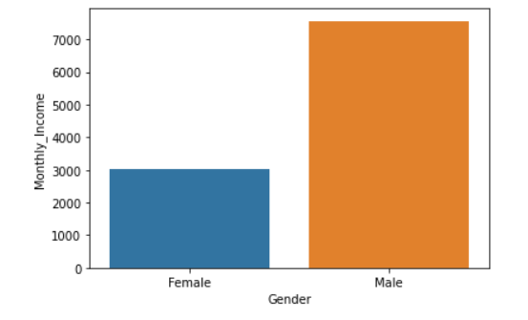
What is average monthly income for each gender?
Gender | Monthly Income
Male | 7567.884418
Female | 3010.912985
The average monthly income of
males is higher and therefore
they are more accepting of loans

Slide 21
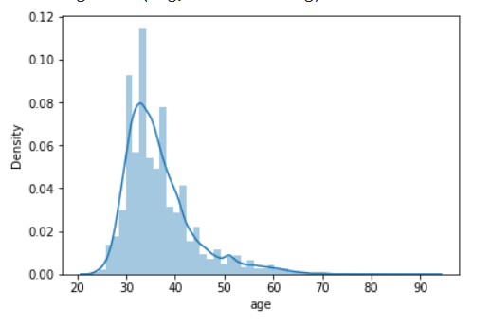
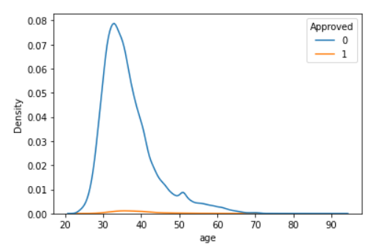
Is age of applicant affect approved ?
Distribution of age of applicant
The effect of age on acceptance
- Age does not affect acceptance

Slide 22
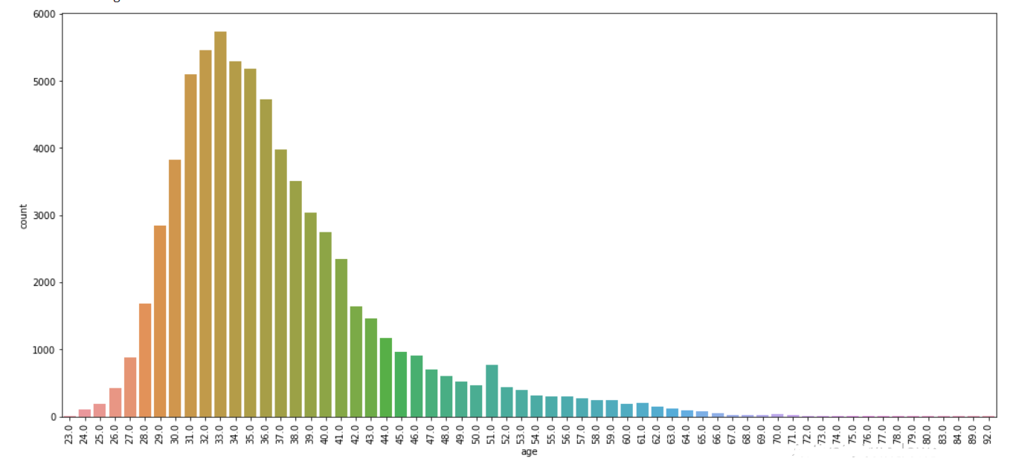
At what age is the demand for loan ?
- Customers in the age of thirty are the most requesting for a loan, while those at the age of seventy are the least

Slide 23
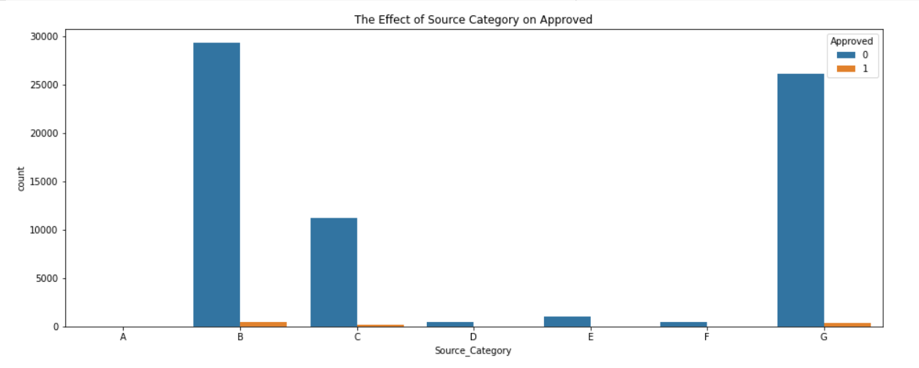
Which source category is the most rejecting of loans?
Source Category | Approved | Count
A | 0 | 3
B | 0 | 29317
 | 1 | 495
C | 0 | 11234
 | 1 | 140
D | 0 | 497
E | 0 | 1035
 | 1 | 15
F | 0 | 453
 | 1 | 6
G | 0 | 26154
 | 1 | 364
- source category (B) is the most rejected for Loans.

Slide 24


Summary
Customers are heading towards a 5-year repayment period because the interest rate for the loan is low, unlike the 6-year repayment period
Category C clients are the lowest in the average monthly income and the most in the average loan value
Category No. 3 of clients is the lowest in the average monthly income and the lowest in the average loan value
The average monthly income of those accepted for the loan is greater than the rejected ones
The total of those accepted for the loan does not exceed 2% of the total applicants for the loan
There is a positive relationship between the value of the amount of loans and the value of the monthly installment
More than half of the bank's clients are male and they are more approved
The age of the customer does not affect the acceptance of the loan from its rejection

Slide 25



Thank you Your Opinion!
000000000
​
Mahmoud Reda
eltabakhm703@gmail.com
https://www.linkedin.com/in/mahmoud-eltabakh-4209841b9

